Slide 1


APPLE STOCK FORECAST
MEMBERS OF PROJECT
1.Nidhi Pandey
2.Mrs Sirisha Akella
3.Pankhuri Sharma
4.Anshul Krishna
5.H N Shravan Kumar
6.Onkar Satish Thorawade

Slide 2



What is The
BUSINESS
OBJECTIVE
Predict the apple stock Market price for next 30 days

Slide 3

1.Open : It is the first price at which the asset is traded at the beginning of a trading session
2.High: High Price represents the highest price at which the asset was traded during session.
3. Low: It is the lowest price at which the asset was traded during the trading session
4.Close: It is the last price at which the asset was traded.
5.Adjusted Close: It reflects the assets closing price for any actions that affects its value
Dataset Overview

Slide 4

Steps to EDA
1.Import Python Libraries
2.Reading Dataset
3.Analyzing data using data.head(),data.shape , data.info , data.describe.
4.Check for Duplicates , missing values.
5.Heat Map for Correlation of dataset
6.Visualizing the dataset
7.Rolling Mean , Boxplot of each column.
8. Resampling , Stationarity of dataset.

Slide 5
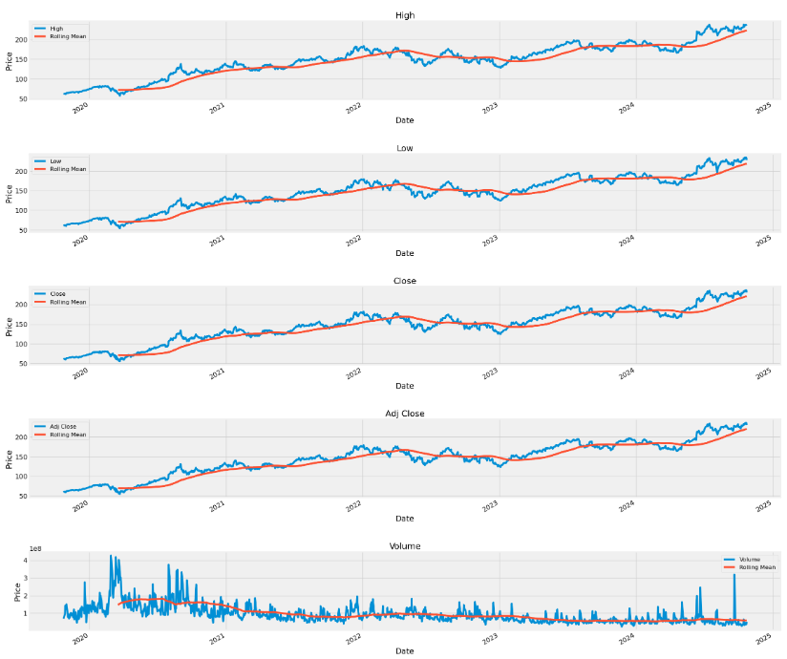
Open, High ,Low ,Close and Adjusted Close is showing increasing Trend but Volume has a zigzag movement more in year 2020 because of Covid.
So fluctuations in volume are observed during year 2020 more comparative to upcoming years

Slide 6
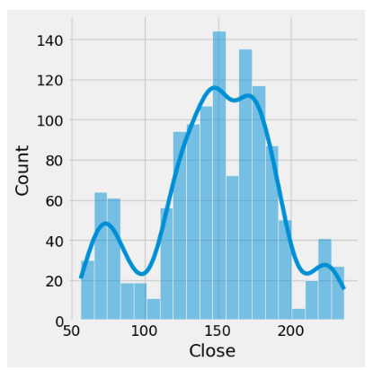
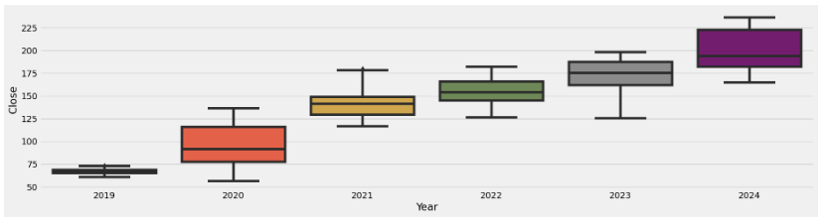
Above boxplot indicates that there is a significant difference in close price between year 2019 and 2020 ,it must be because of covid.But after that there is slow increasing graph of closing price
For understanding the behaviour of Closing amount ,above graph shows that the Close figure is approximate around 150

Slide 7
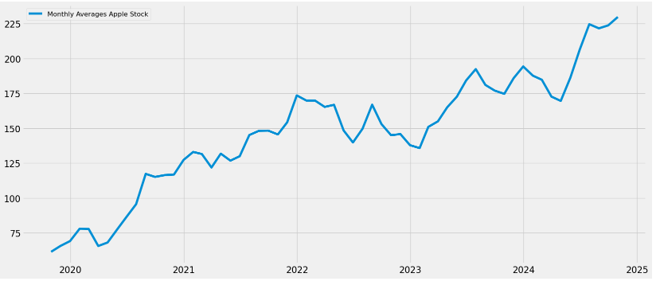
Monthly average stock of apple shows a gradual increase with the year 2022-2025 with the sharp hike in 2025 start. This signify the recovery post Covid.

Slide 8
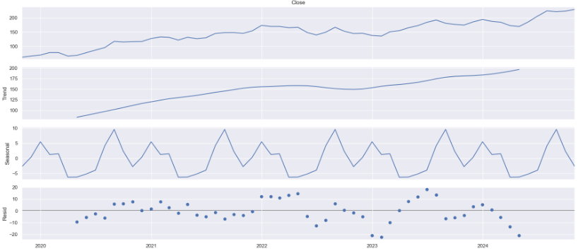
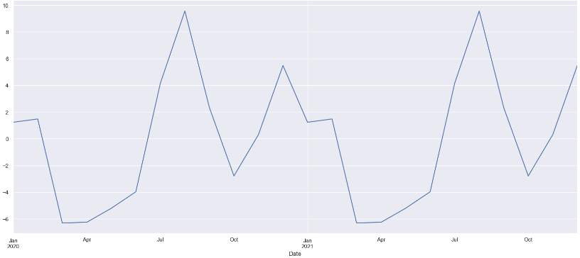
For observing the sale we have tried plotting the seasonality graph , after which we can say that there is a spike around the month of july

Slide 9
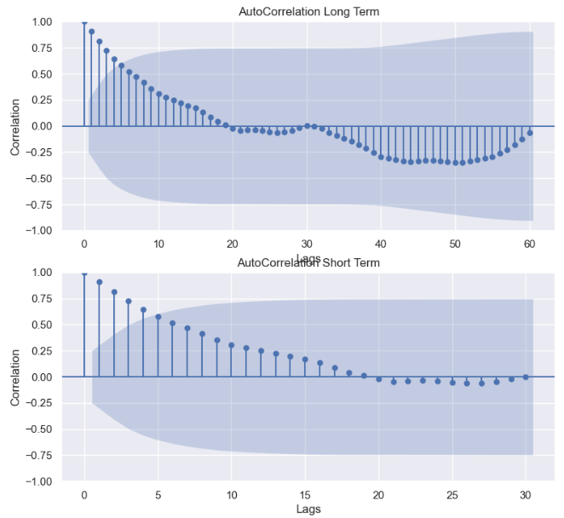
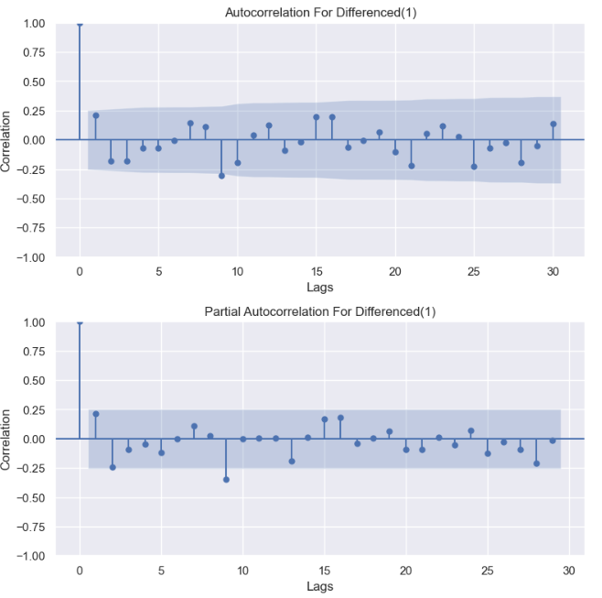
Time series is not random and good for time series modelling , but it was non-stationary.
Performed Differencing for making series a stationary .

Slide 10
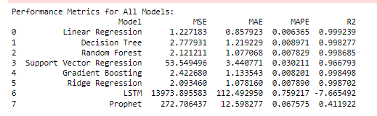
Finding the best model

Slide 11
Linear Regression :This model has exceptional performance, with extremely low error values and a very high R² score, suggesting that it fits the data nearly perfectly.
Desision Tree: Decision Trees perform well but have slightly higher error rates than Linear Regression, though the R² is still very high.
Random Forest:Random Forests offer good predictive accuracy, with a performance similar to Decision Trees but with a slightly lower MSE and MAE.
SVR: Shows a significant drop in performance compared to the other models, with very high errors and a low R², suggesting it's not a good fit for this data.
Gradient Boosting :Gradient Boosting is a strong contender, with low error rates and a high R², though it's slightly worse than Random Forest in terms of MSE and MAE.
Ridge,LSTM ,Prophet : Performs poorly. Low R2 and high MSE,MAEs.

Slide 12
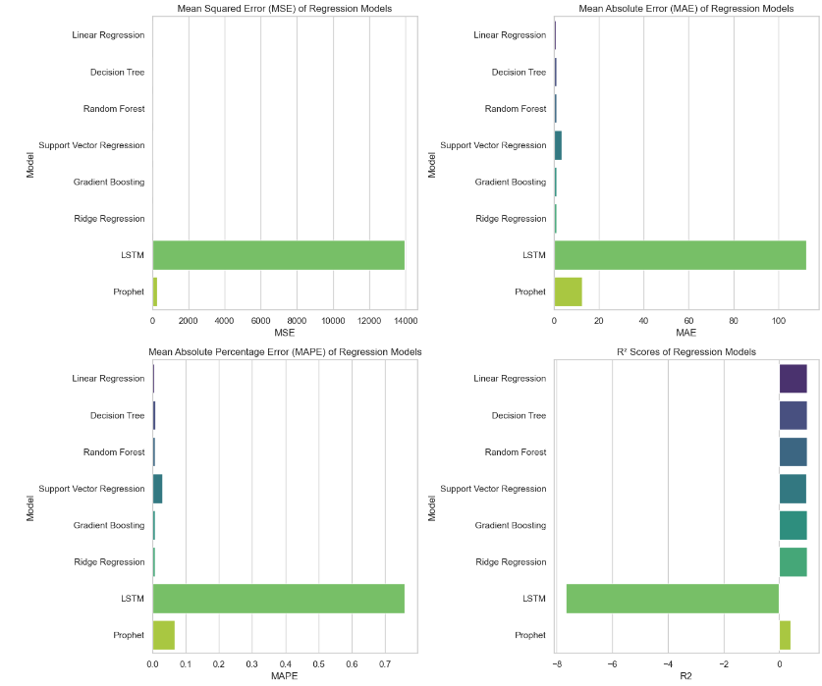

Slide 13
Top performer : Linear Regression is the standout model, followed closely by Random Forest, Ridge Regression, and Gradient Boosting, all of which show excellent results with very low error metrics and high R² values.
Worst Performer : LSTM and Prophet show poor performance, with LSTM having the highest errors and negative R², while Prophet has a low R² and high MAE/MAPE, suggesting that it doesn't capture the data well.
On the performance metrics, Linear Regression would be the first choice for this task, given its near-perfect fit to the data

Slide 14
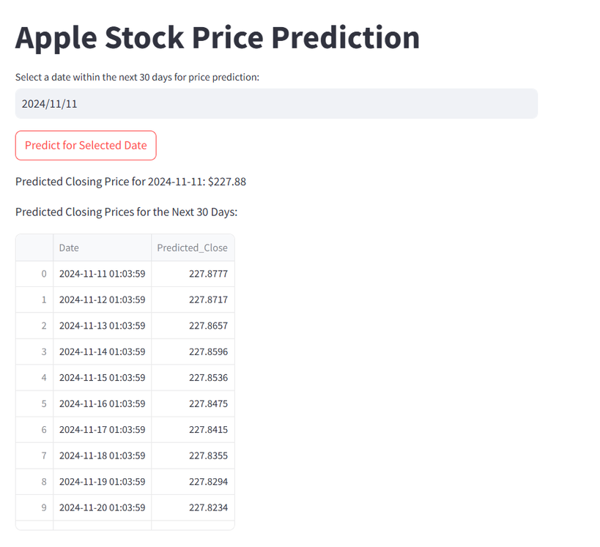
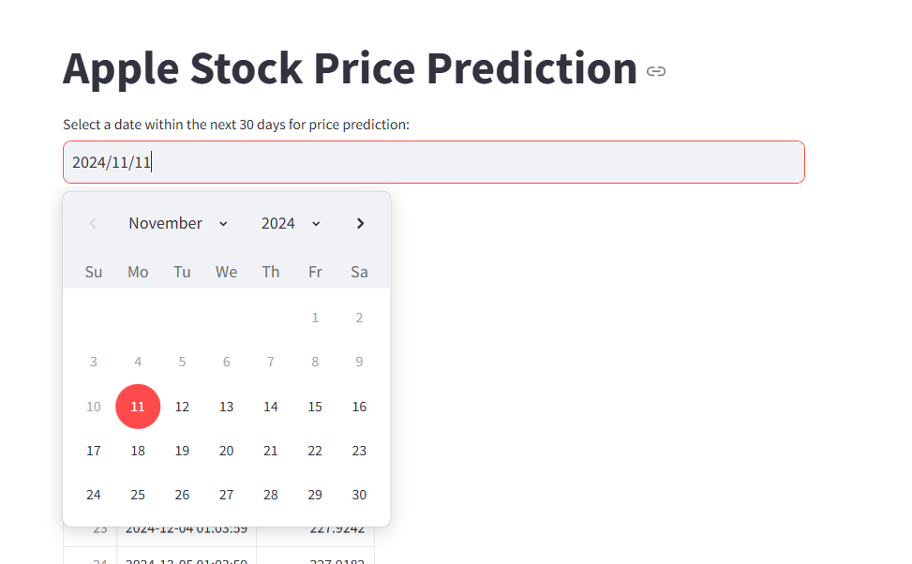
Deployment
Providing the date as input for our model to forecasting the stock of Apple in next 30day .

Slide 15



Conclusion
The forecasting analysis for Apple’s stock performance has successfully identified Linear Regression as the most accurate and reliable model for predicting future stock movements. With an R² score nearing perfection, Linear Regression outperforms other models, such as Random Forest and Gradient Boosting, in terms of precision and stability.
The time series data was adjusted for non-stationarity, ensuring the model's robustness and applicability. Observations from the analysis show a consistent post-COVID growth trajectory for Apple's stock, with a notable surge anticipated in early 2025. These findings offer valuable insights for investors and stakeholders looking to make informed decisions about Apple's stock.

Slide 16
In Summary , Linear Regression is the preferred method for forecasting Apple's stock price, providing the most accurate and actionable predictions based on the available data. The analysis not only highlights current trends but also suggests a positive outlook for Apple's financial performance in the near future.
Thank You

